Slide 1
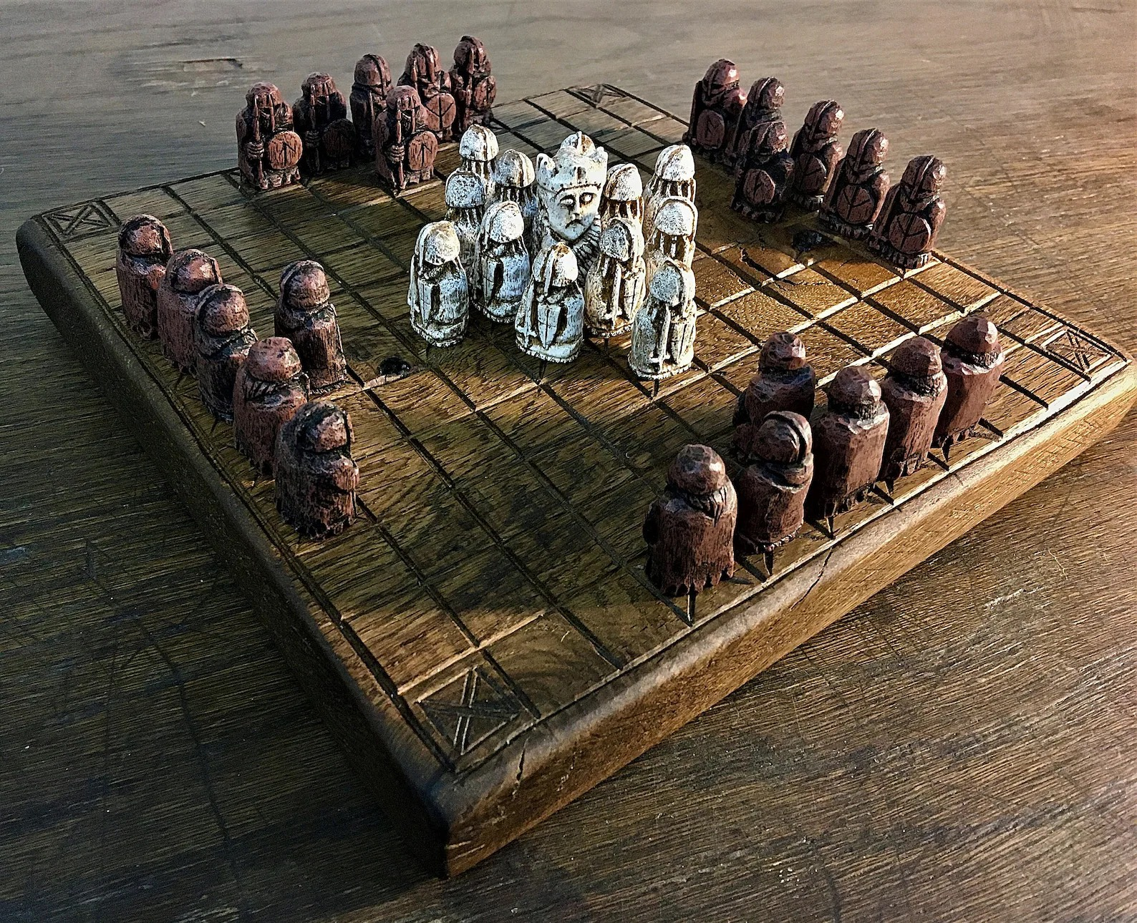
TABLUT CHALLENGE 2023
Christian Di Buò
Alberto Genovese
Simone Reale
Alessandro Tutone
by NordSudOvestEst

Slide 2
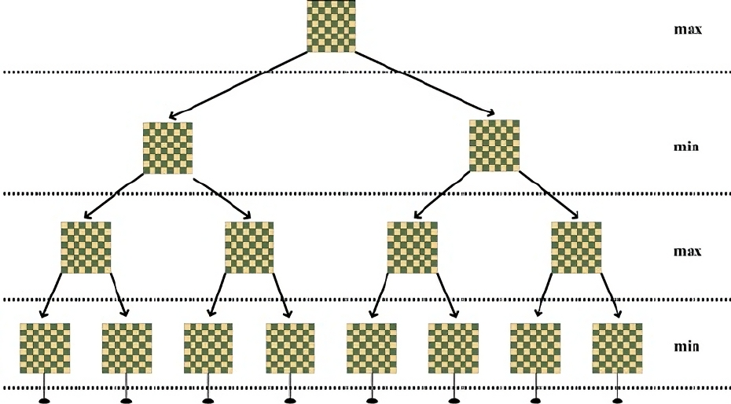
Our Strategy
Iterative deepening
Alpha-beta cuts

Slide 3
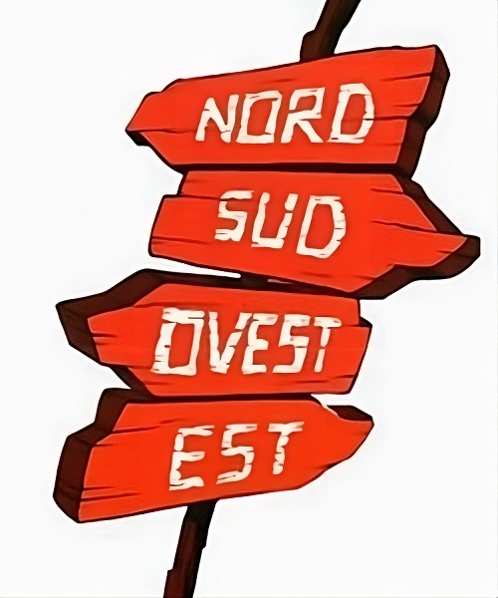
Black’s Heuristic
Our evaluation is based on:
Strategic Positions
Number of Black Pawns
Number of White Pawns
King’s Position
Check Sides
Average Black Pawns Distance from the King

Slide 4
White’s Heuristic
Our evaluation is based on:
Strategic Positions
Pawns
King
Number of White Pawns
Density of Black Pawns
King Distance from Exits

Slide 5
Thanks for your attention!

